Slide 1
Marketing Management
Chapter One

Slide 2
Marketing Definition
Marketing is a process by which companies create value for customers and build strong customer relationships to capture value from customers in return.

Slide 3
Marketing Process
This figure shows marketing in a nutshell. By creating value for customers, marketers capture value from customers in return.
Understand the marketplace and customer needs and wants
Design customer-driven marketing strategy
Construct an integrated marketing program that delivers superior value
Build profitable relationships and create customer delight
Capture value from customers to create profits and customer equity
Create value for customers and build customer relationships
Capture value from customers in return

Slide 4
1. Understanding the Marketplace and Customer Needs
1.1. Customer Needs, Wants, Demands
  Customer Needs
States of felt deprivation
  Physical—food, clothing, warmth, safety
  Social—belonging and affection
  Individual—knowledge and self-expression
Wants:
Wants are the forms of human needs but they are shaped by culture.
  Hunger is my need but I want rice with raita or naan with karahi but a person in Malaysia may want a bowl of rice with fish
Demands:
Human wants backed by buying power.

Slide 5
Cont.
1.2 Market offerings
Combination of products, services, or experiences offered to a market to satisfy a need or a want.
Marketing myopia
focusing only on existing wants and losing sight of underlying consumer needs.
1.3 Customer Value and Satisfaction
  There are two aspects to customer value: desired value and perceived value.
    Desired value refers to what customers desire in a product or service.
    Perceived value is the benefit that a customer believes he or she received from a product after it was purchased. If the desired value and perceived value is same then customer satisfaction is achieved.

Slide 6

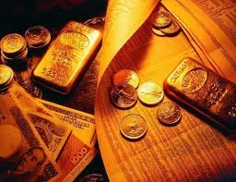
1.4 Exchanges and Relationships
Exchange
  the act of obtaining a desired object from someone by offering something in return
Relationship
  Marketing actions try to create, maintain, grow exchange relationships.

Slide 7
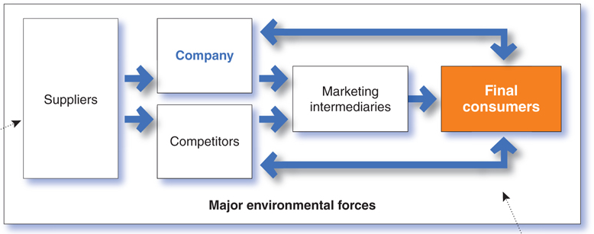
1.5 Markets
Markets are the set of actual and potential buyers of a product. Each party in the system adds value.
    Walmart cannot fulfill its promise of low prices unless its suppliers provide low costs.
    Ford cannot deliver a high-quality car-ownership experience unless its dealers provide outstanding service.
  Arrows represent relationships that must be developed and managed to create customers value and profitable customer relationships.

Slide 8
2. Designing a Customer Driven Marketing Strategy
Define marketing management is the art and science of choosing target markets and building profitable relationships with them.
What customers will we serve (what’s our target market)?
How can we serve these customers best (what’s our value proposition or positioning)?

Slide 9
Selecting Customers to Serve
Market segmentation refers to dividing the markets into segments of customers.
Target marketing refers to which segments to go after.

Slide 10
Choosing a Value Proposition
A brand’s value proposition is the set of benefits or values it promises to deliver to consumers to satisfy their needs.
Tag Line of brands
Apple “Think different”
Nokia “Connecting People”

Slide 11
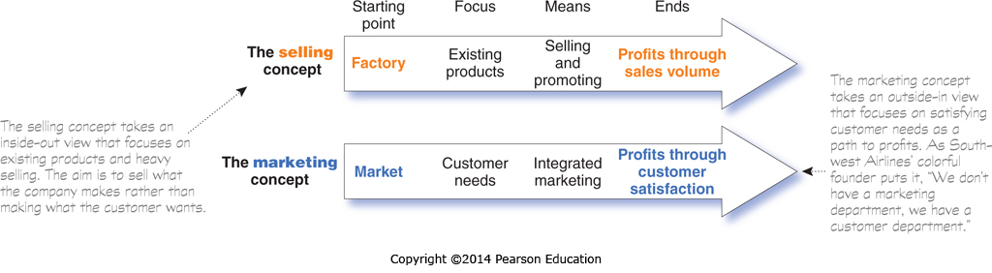
Marketing Management Orientations
The Production Concept: low production costs, high production efficiency and mass production.
The Product Concept: consumers will prefer products that have better quality, performance and features as opposed to a normal product
The Selling Concept: The selling concept takes an inside-out view that focuses on existing products and heavy selling. The aim is to sell what the company makes rather than making what the customer wants.
The marketing concept: takes an outside-in view that focuses on satisfying customer needs as a path to profits. As South-west Airlines’ colorful founder puts it, “We don’t have a marketing department, we have a customer department.”

Slide 12
Marketing Management Orientations
The Societal Marketing Concept
The societal marketing concept holds that marketing strategy should deliver value to customers in a way that maintains or improves both the consumer’s and society’s well-being.

Slide 13
3. Preparing an Integrated Marketing Plan and Program
(Marketing Mix)
The marketing mix is the set of tools (four Ps) the firm uses to implement its marketing strategy. It includes product, price, promotion, and place.
Product
Price
Place
Promotion
The firm must blend each marketing mix tool into a comprehensive integrated marketing program that communicates and delivers the intended value to chosen customers.

Slide 14
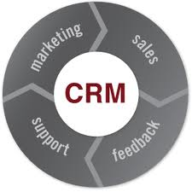
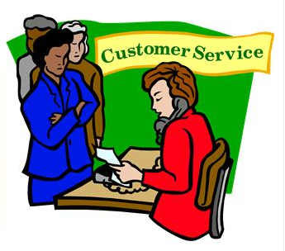
4. Customer Relationship Management (CRM)
In this broader sense, customer relationship management is the overall process of building and maintaining profitable customer relationships by delivering superior customer value and satisfaction.

Slide 15


a. Relationship Building
A customer buys from the firm that offers the highest customer-perceived value—the customer’s evaluation of the difference between all the benefits and all the costs of a market offering relative to those of competing offers.
Customer satisfaction depends on the product’s perceived performance relative to a buyer’s expectations. If the product’s performance falls short of expectations, the customer is dissatisfied.

Slide 16
b. Customer Relationship Levels and Tools
Frequency marketing programs that reward customers who buy frequently or in large amounts.
Club marketing programs that offer members special benefits and create member communities.

Slide 17
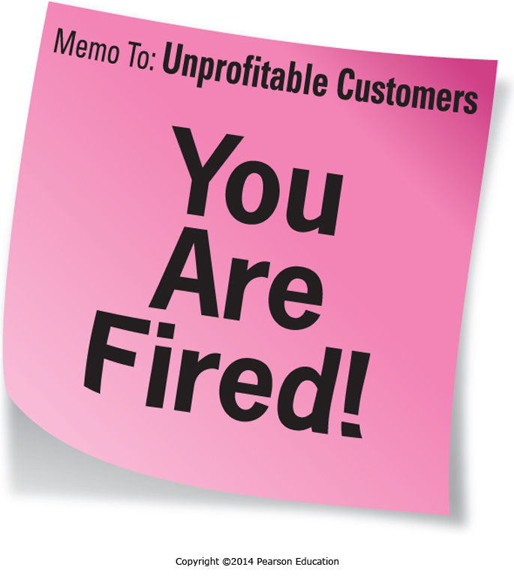
c. The Changing Nature of Customer Relationships
Companies are building deeper, more direct, and lasting relationships with more carefully selected customers.
Today, most marketers realize that they don’t want relationships with every customers. Instead, they target fewer, more profitable customers.

Slide 18
d. Relating More Deeply and Interactively
Relating more deeply and interactively by incorporating more interactive two way relationships through blogs, Websites, online communities and social networks.
Today’s consumers have more information about brands than ever before, and they have a wealth of platforms for airing and sharing their brand views with other consumers. Thus, the marketing world is now embracing not only customer relationship management, but also customer-managed relationships.
A growing part of the new customer dialogue is consumer-generated marketing, by which consumers themselves are playing a bigger role in shaping their own brand experiences and those of others.

Slide 19
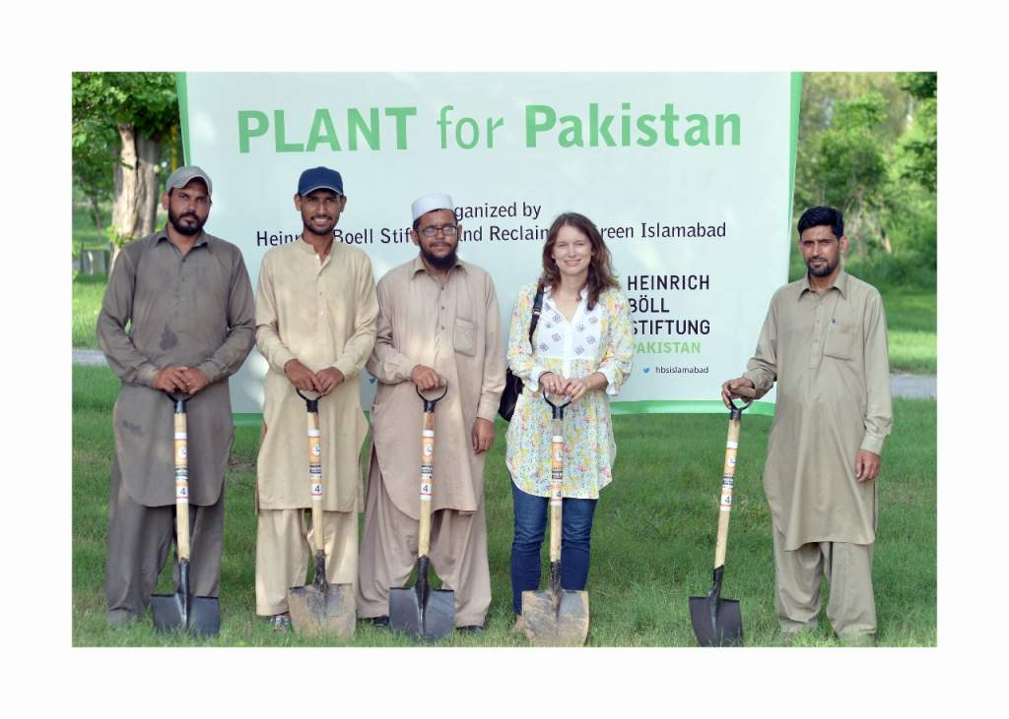
e. Partner relationship management
In addition to being good at customer relationship management, marketers must also be good at partner relationship management—working closely with others inside and outside the company to jointly bring more value to customers.
  Pakistan Plant Drive

Slide 20
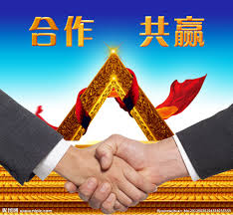
f. Partner relationship management
In today’s more connected world, every functional area in the organization can interact with customers. The new thinking is that—no matter what your job is in a company—you must understand marketing and be customer focused.

Slide 21
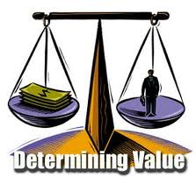
5. Capturing Value from Customers
The final step involves capturing value in return in the form of sales, market share, profits and customer equity.
In addition, by creating superior customer value, the firm creates highly satisfied customers who stay loyal and buy more. This, in return, means greater long-run returns for the firm.

Slide 22
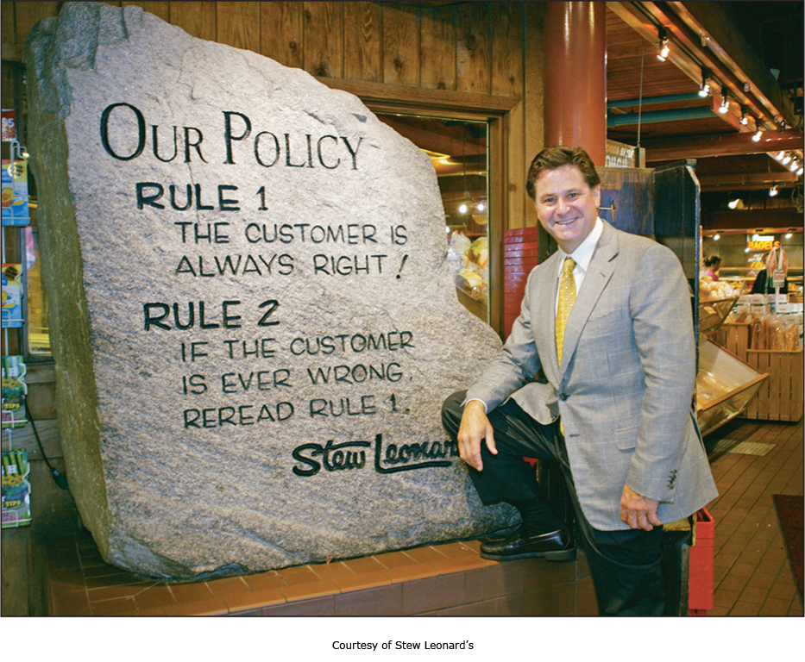
Creating Customer Loyalty and Retention
Customer lifetime value is the value of the entire stream of purchases that the customer would make over a lifetime of patronage

Slide 23
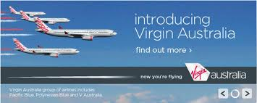
Growing Share of Customer
Beyond simply retaining good customers to capture customer lifetime value, good customer relationship management can help marketers increase their share of customer—the share they get of the customer’s purchasing in their product categories.

Slide 24
Building Customer Equity
Customer equity is the total combined customer lifetime values of all of the company’s current and potential customers.
  Awareness
  Brand Image
  Perceived Quality
  Loyalty

Slide 25
The Changing Marketing Landscape
The Digital Age
The Growth of Not-for-Profit Marketing
Rapid Globalization
Sustainable Marketing ─ The Call for More Social Responsibility

Slide 26
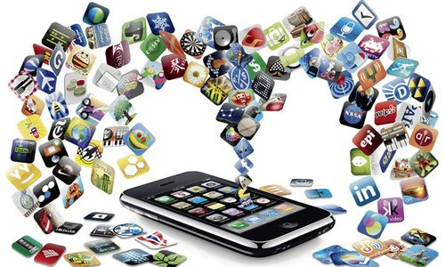
The Digital Age
The digital age has provided marketers with exciting new ways to learn about and track customers and create products and services tailored to individual customer needs.
Online marketing is now the fastest-growing form of marketing.

Slide 27


The Growth of Not-for-profit Marketing
In recent years, marketing has also become a major part of the strategies of many not-for-profit organizations, such as colleges, hospitals, museums, zoos, symphony orchestras, and even churches.
Government agencies have also shown an increased interest in marketing.

Slide 28
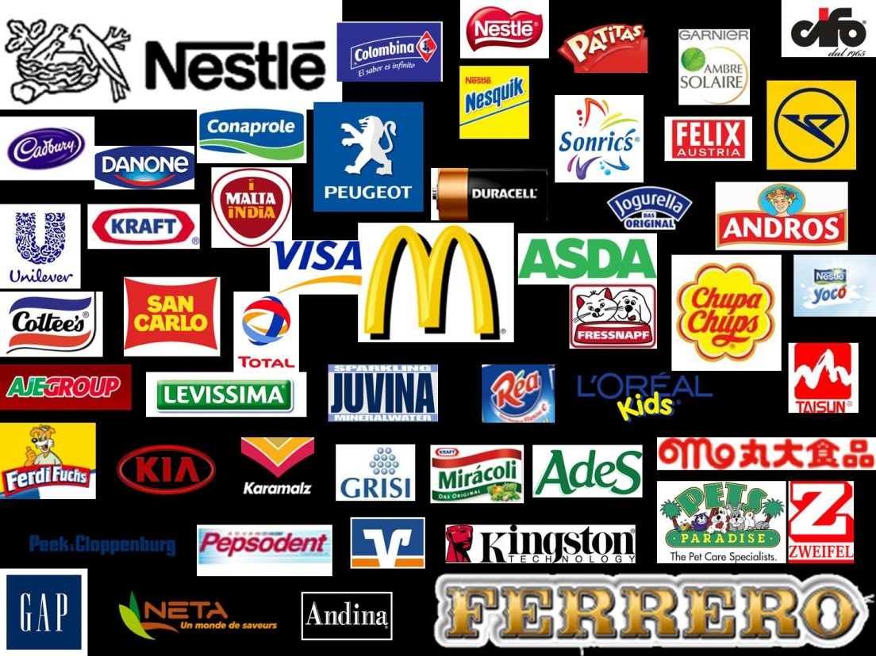
Rapid Globalization
Today, almost every company, large or small, is touched in some way by global competition.
Managers in countries around the world are increasingly taking a global, not just local, view of the company’s industry, competitors, and opportunities.

Slide 29
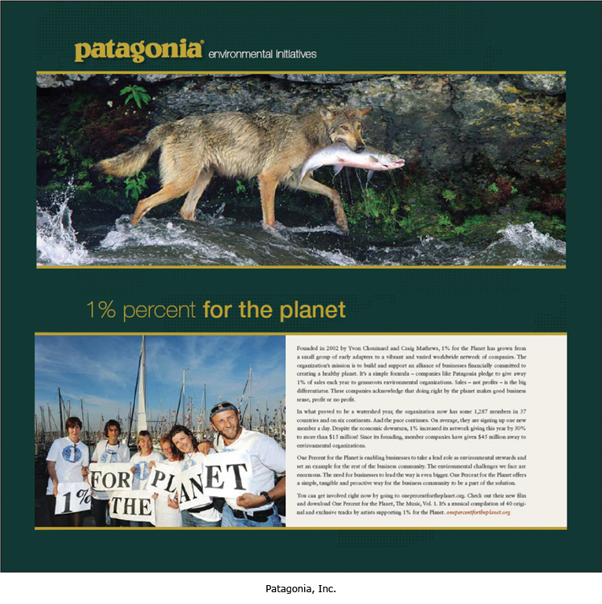
Sustainable Marketing ─ The Call for More Social Responsibility
As the worldwide consumerism and environmentalism movements mature, today’s marketers are being called on to develop sustainable marketing practices.
Corporate ethics and social responsibility have become hot topics for almost every business.

